Slide 1
How to calculate the output shape of convolution, deconvolution and pooling layers in CNNs for 2D input?

Slide 2

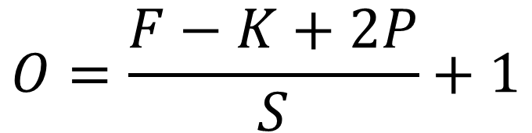

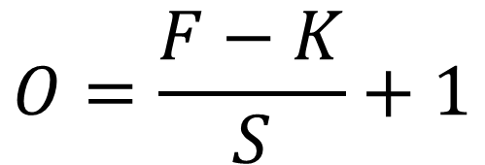
Formulas
$$O=\frac{F−K+2P}{S}+1$$
Convolution →
Deconvolution →
$$O=S×\left(F−1\right)+K−2P$$
$$O=\frac{F−K}{S}+1$$
Pooling →
Here, $O=$ Output shape, $F=$ Input shape, $K=$ Kernel size,
$S=$ Stride, $P=$ Padding

Slide 3
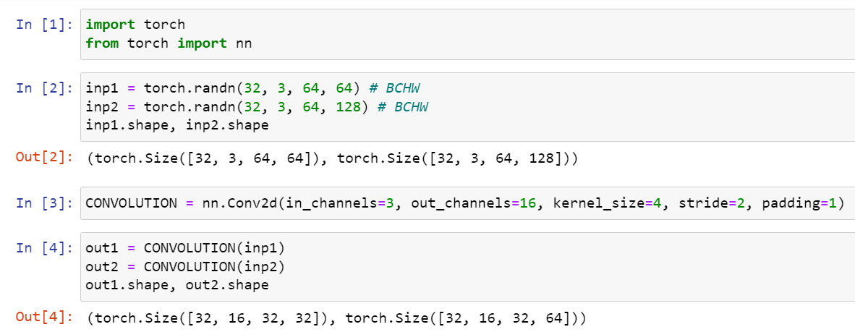

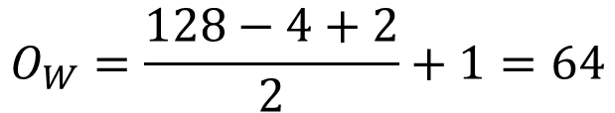
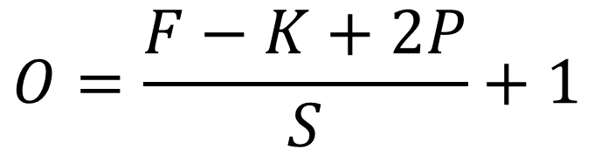
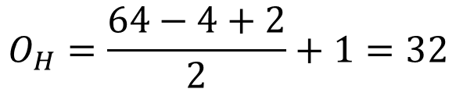

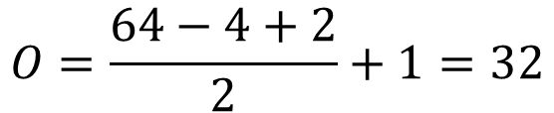
Convolution
$$O=\frac{F−K+2P}{S}+1$$
Channels will be equal to the number of output channels indicated in the convolution operation.
$$O=\frac{64−4+2}{2}+1=32$$
For input 1,
$$F=F_{H}=F_{W}$$
$$O_{H}=\frac{64−4+2}{2}+1=32$$
$$O_{W}=\frac{128−4+2}{2}+1=64$$
For input 2,
$$F_{H}≠F_{W}$$

Slide 4
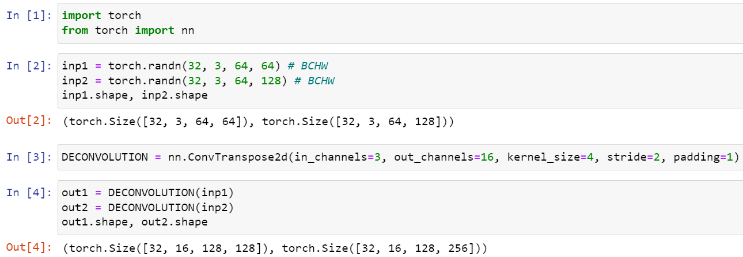



Deconvolution
$$O=S×\left(F−1\right)+K−2P$$
Channels will be equal to the number of output channels indicated in the deconvolution operation.
For input 1,
$$O=2×\left(64−1\right)+4−2=128$$
$$F=F_{H}=F_{W}$$
For input 2,
$$O_{H}=2×\left(64−1\right)+4−2=128$$
$$F_{H}≠F_{W}$$
$$O_{W}=2×\left(128−1\right)+4−2=256$$

Slide 5
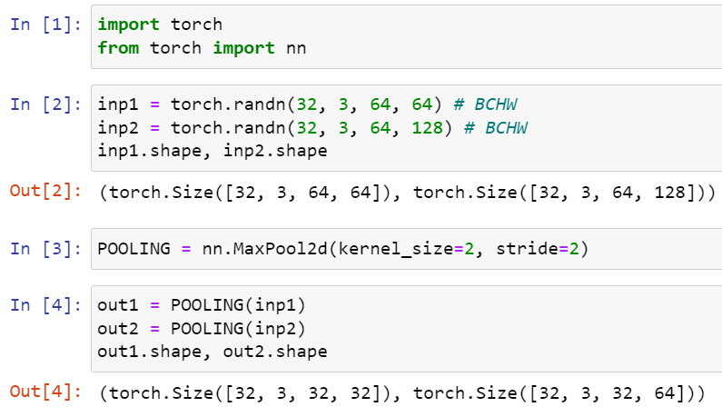
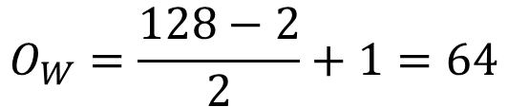

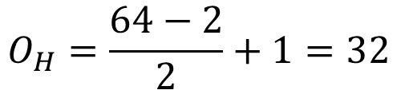

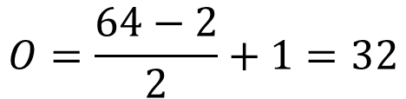
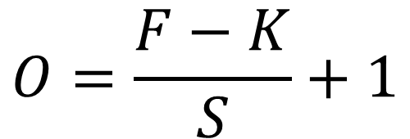
Pooling
$$O=\frac{F−K}{S}+1$$
Pooling does not deal with the channels. Output tensor will have the same number of channels as the input tensor.
$$O=\frac{64−2}{2}+1=32$$
For input 1,
$$F=F_{H}=F_{W}$$
$$O_{H}=\frac{64−2}{2}+1=32$$
$$O_{W}=\frac{128−2}{2}+1=64$$
For input 2,
$$F_{H}≠F_{W}$$

Slide 6
THE END

